Slide 1
The Package Smart-Lock
PRESENTED BY: FINN BASTIAN, AMARI OLIVACCE, FAIYAZ SAJJAD, JUSTIN PAIGE

Slide 2
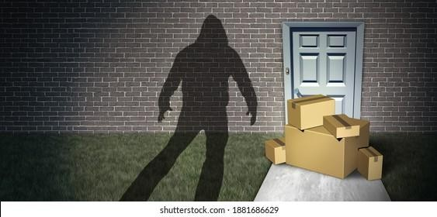
The Problem
▶ 58 Million Americans victim to porch
pirates
▶ Medium sized packages frequently
targeted
▶ Current solutions limited on shape and
size of package

Slide 3
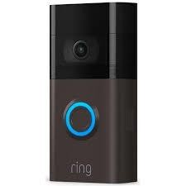
Existing Attempts to Solve Porch Piracy
Solution 1: Ring Video Doorbell Pros:
▶ Captures video
▶ Alerts user
▶ Real time communication
▶ Deters theft
Cons:
▶ Doesn't physically protect packages

Slide 4
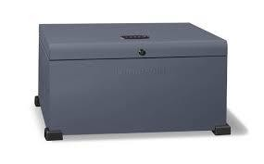
Existing Attempts to Solve Porch Piracy
Solution 2: Landport Lockbox Pros:
▶ Durable
▶ Secured deliveries/ retrievals
Cons:
▶ Package size and shape limited
▶ Unable to secure multiple packages

Slide 5
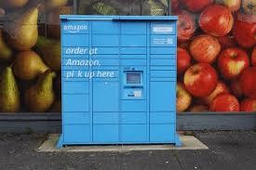
Existing Attempts to Solve Porch Piracy
Solution 3: Amazon Hub Locker Pros:
▶ Location deters thefts
▶ Lockers secure packages
▶ Self service
Cons:
▶ Limits package size
▶ No Third-party deliveries
▶ Inconvenient for user

Slide 6

Our Solution
The Package Smart Lock:
▶ Attachable to any entry point (doors, gates, hatches, lockers, and more)
▶ Creates a custom secured storage
▶ All package size and shapes supported

Slide 7
Critical System Requirements
▶ Lockability
▶ Un-lockability
▶ Passcode Recognition

Slide 8
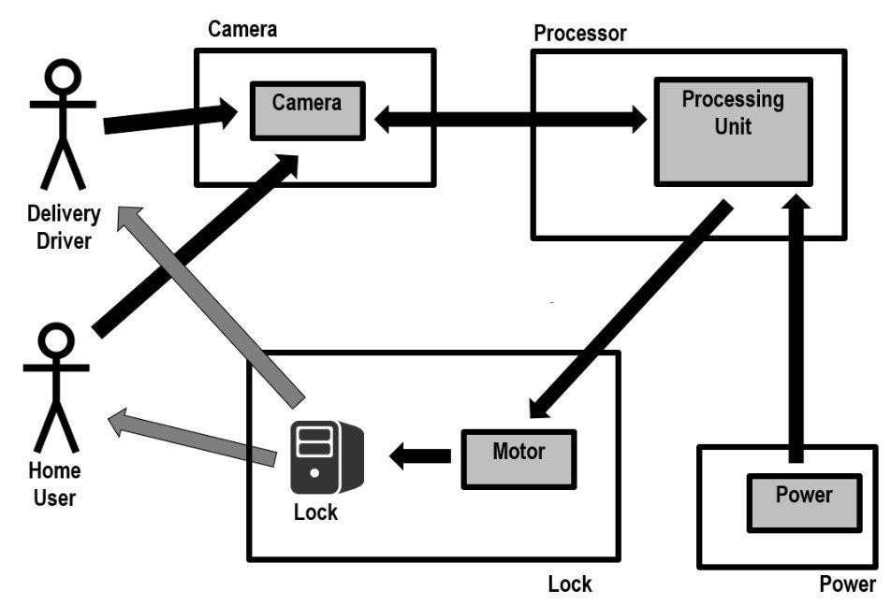
HIGH LEVEL DESIGN

Slide 9
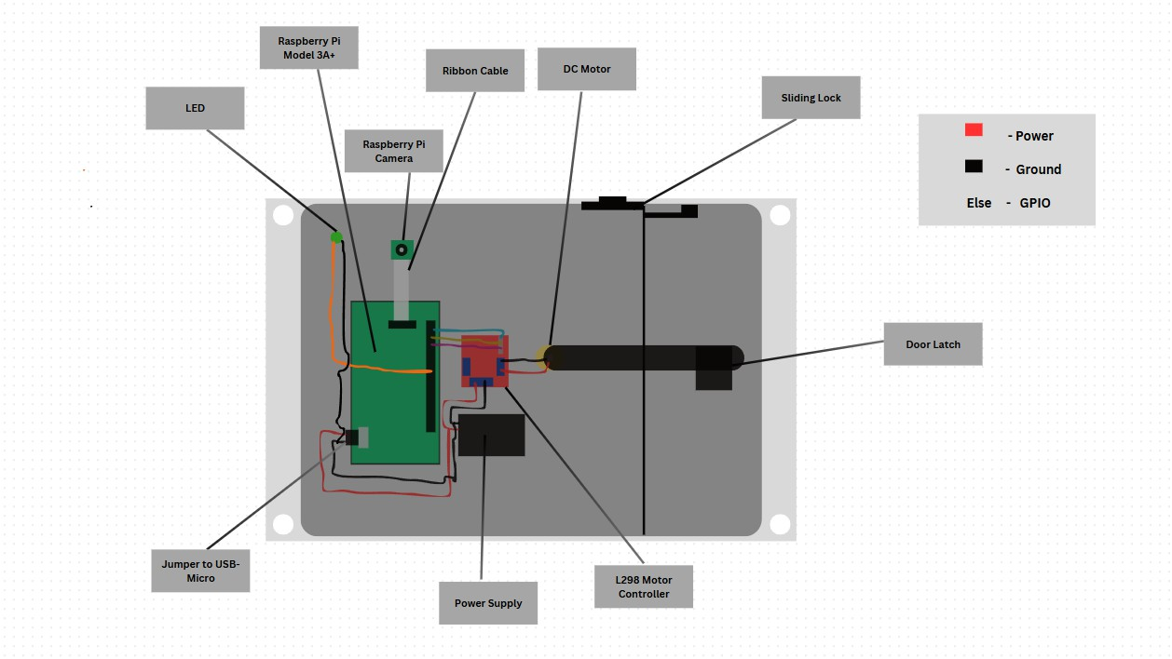
LOW LEVEL DESIGN

Slide 10
Package Smart Lock Guide
▶ Add custom passcode through app
▶ Add passcode on Address line 2 for package label
▶ Homeowner shows passcode either printed or electronic to scanner
▶ Delivery Personnel shows package label to scanner

Slide 11
LIVE DEMO

Slide 12
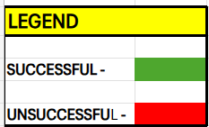
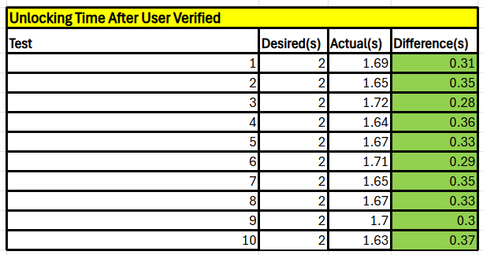
TEST RESULTS
AVERAGE TIME = 1.673 seconds

Slide 13
TEST RESULTS CONTINUED
▶ System scanner successfully recognized valid passcode
▶ System Scanner successfully rejected invalid passcode
▶ Relocking system not yet added

Slide 14
FUTURE WORK
▶ Allow system to be able to relock
▶ Outer shell for the system
▶ Create app for passcode/address setup
▶ Allow system to save recordings in app

Slide 15
Conclusion
▶ Allows homeowners to create a custom secured storage
▶ Passcode Recognition Scanner makes verification simpler
▶ The Package Smart Lock secures packages of any size and shape

Slide 16
WORK CITED
▶ Security.org - https://www.security.org/package-theft/annual-report/
▶ ValuePenguin - https://www.valuepenguin.com/porch-pirates-survey

